Slide 1
ELO
Jivan Kharel, Tony Shi and Mai Trinh

Slide 2
Agenda
Introduction
Technologies
Process
Short Demo
Success and Challenges
Future Approach

Slide 3
Introduction
ELO is a web application that allows Gettysburg College students to buy and sell textbooks from other students at affordable prices. ELO aims to help Gettysburg College students with the surging textbook prices by providing a platform for affordable textbook options.

Slide 4




Technology
PP
S
Payment & card management
Site & users management: site structure, hyperlinks, redirects, user permissions.
J
BC
In app messaging
Market & users management: products (books), pricing, sellers and buyers management, market analytics.
Notes:
Blastchat and paypal just plugins.
Talk about technologies explored like Magento and Wordpress.

Slide 5
Our Process

Slide 6

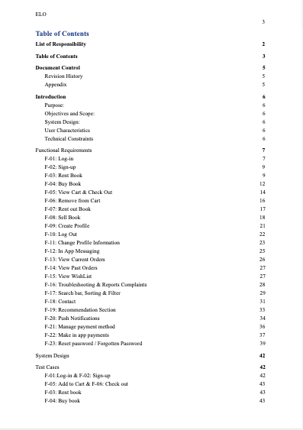

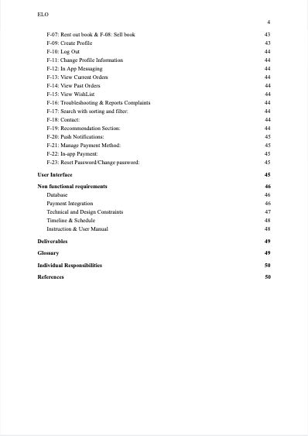
Planning & Requirements

Slide 7
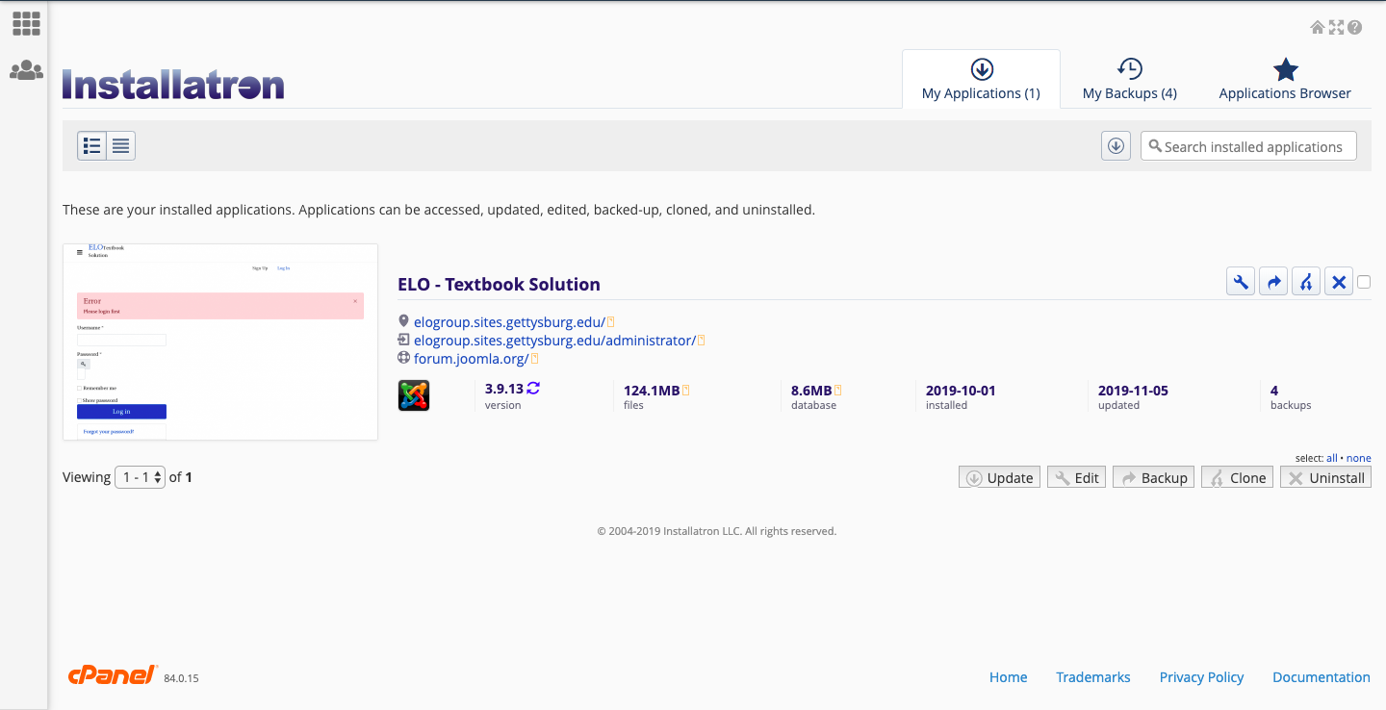
From requirements to implementation

Slide 8
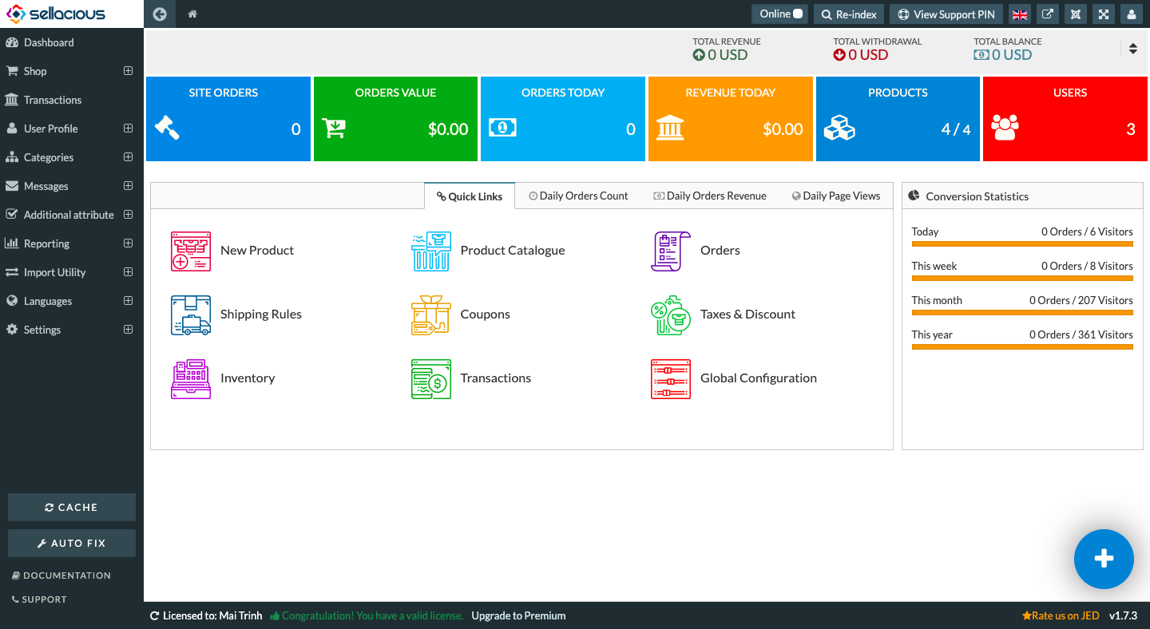
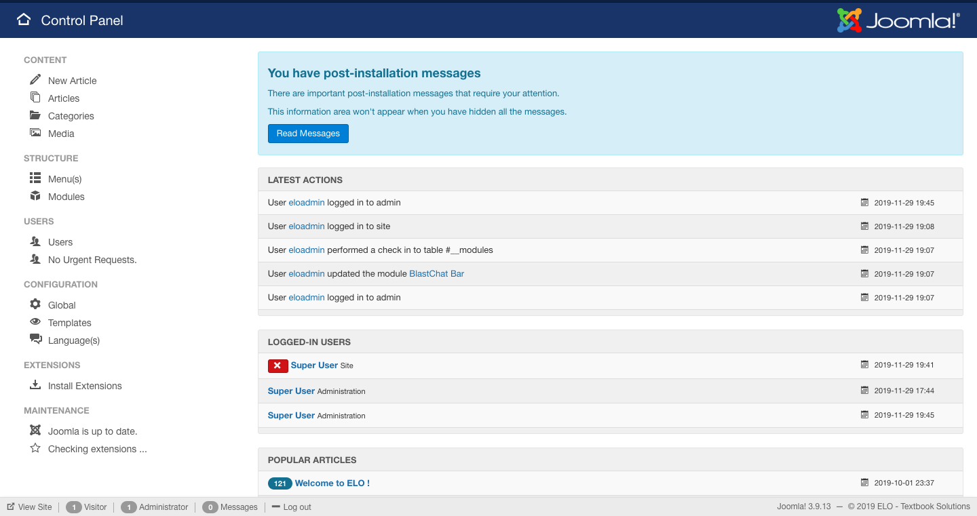
Implementation, Testing, Bug fix

Slide 9
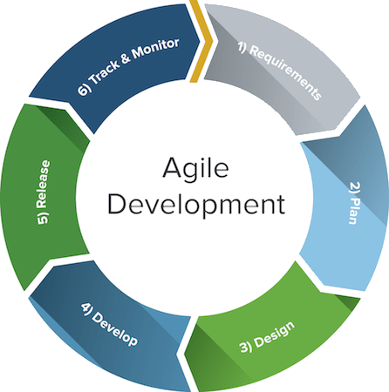
Methodology
Requirements & Document
Group meeting
ELO
Client Meeting
Implement new components & fix existing errors
Test
Notes:
Group meeting + Implement new components & fix errors & Test & Client meeting & Req & Doc

Slide 10
Short demo (of the prototype)
Purchasing a book
Notes:
Scenario: Purchasing a Book on ELO

Slide 11
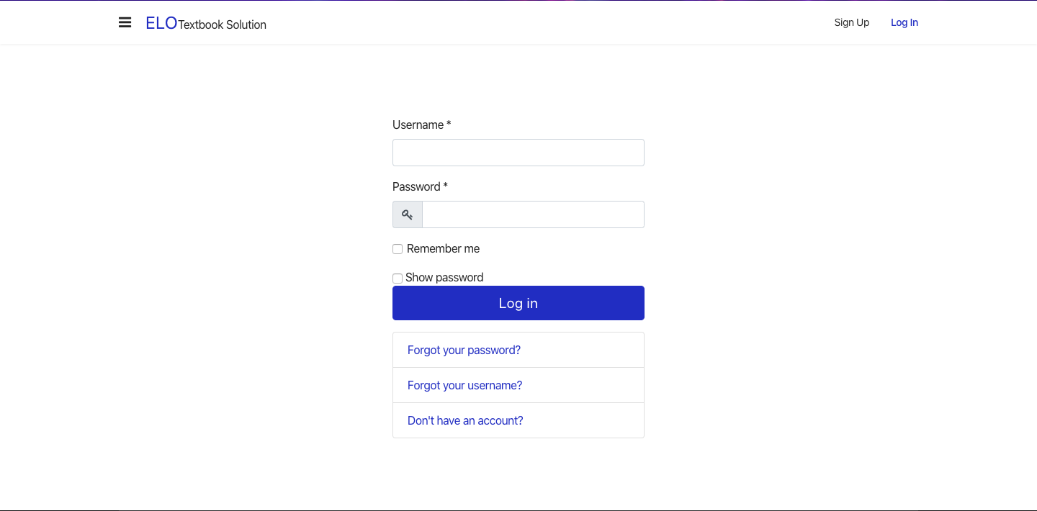
Notes:
Log in portal displays

Slide 12

Notes:
User enters his/her username and password.

Slide 13
Notes:
User clicks on “Log in”

Slide 14
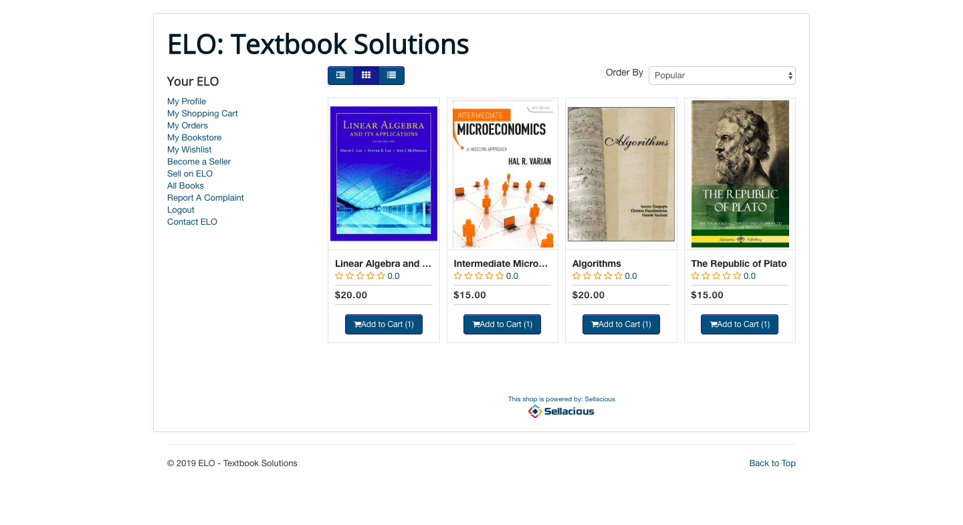
Notes:
The landing page displays with all available books on ELO. Speaker introduce sidebar, book view and sort feature.

Slide 15
Notes:
Let’s say a student wants to sort the books from lowest to highest price. Speaker demonstrates.

Slide 16
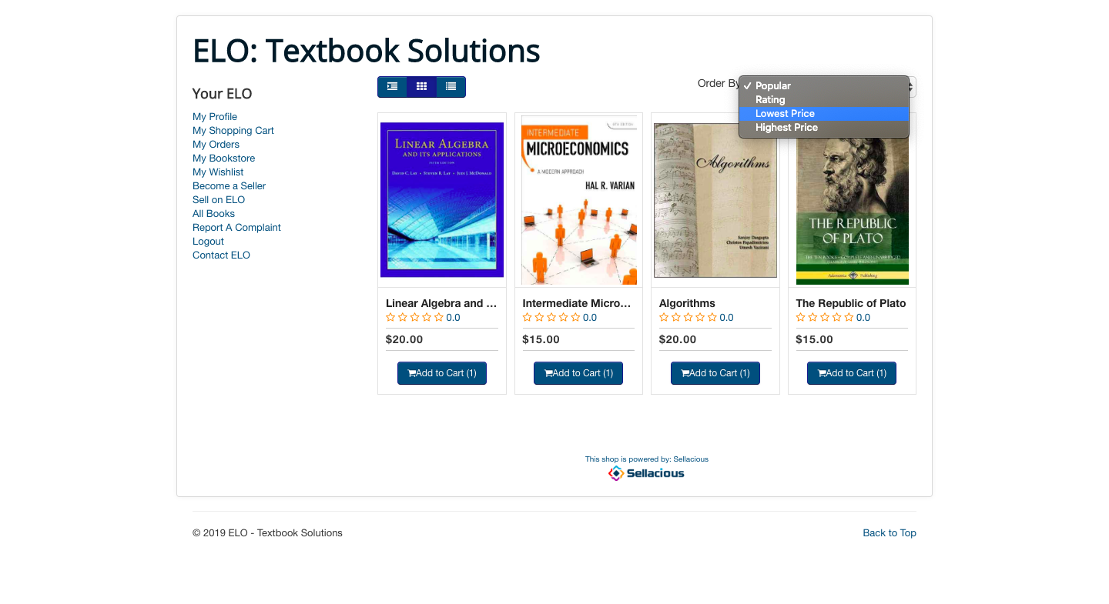
Notes:
Demonstrate sorting by Lowest Price.

Slide 17
Notes:
Demonstrate sorting by Lowest Price.

Slide 18
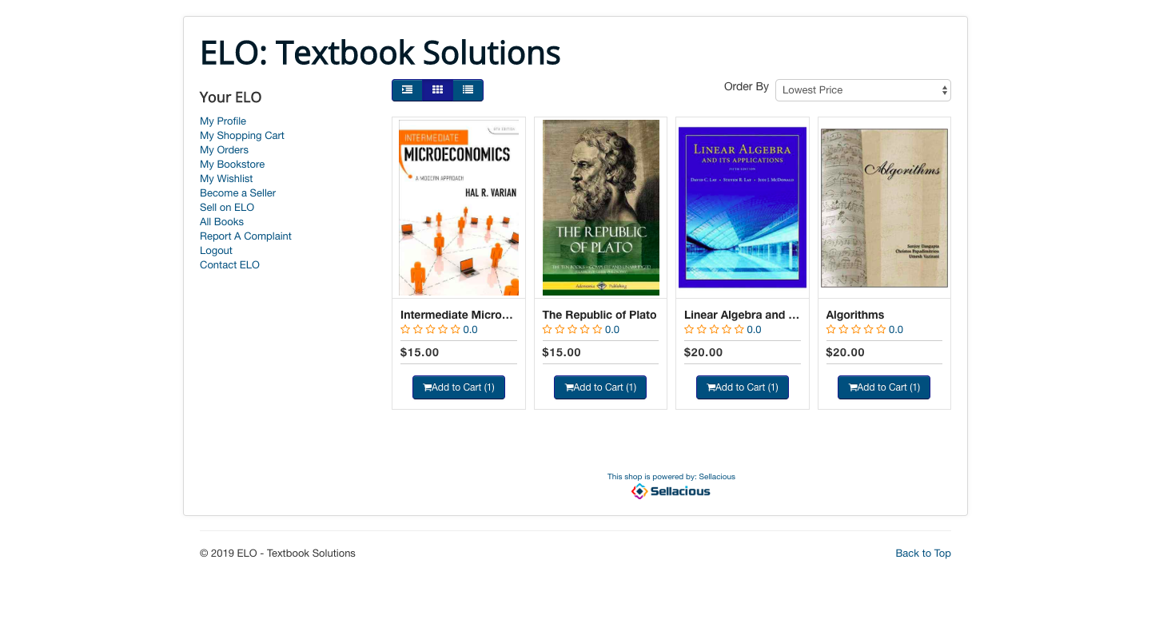
Notes:
The books are now sorted in order from lowest price to highest price.

Slide 19
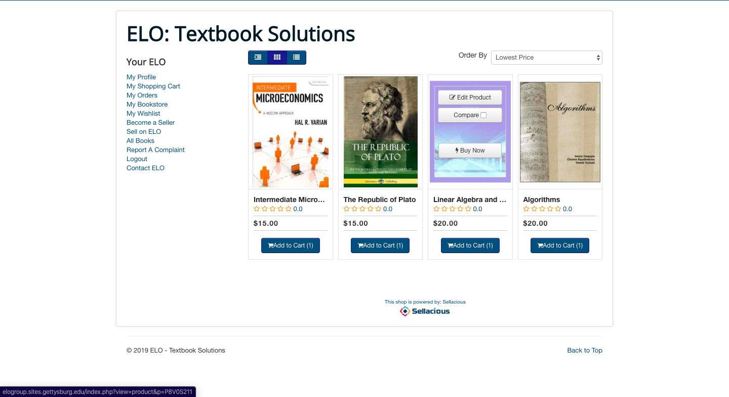
Notes:
Let’s say the student wants to buy “Linear Algebra and its Applications”. Speaker demonstrates. (Click on the book)

Slide 20
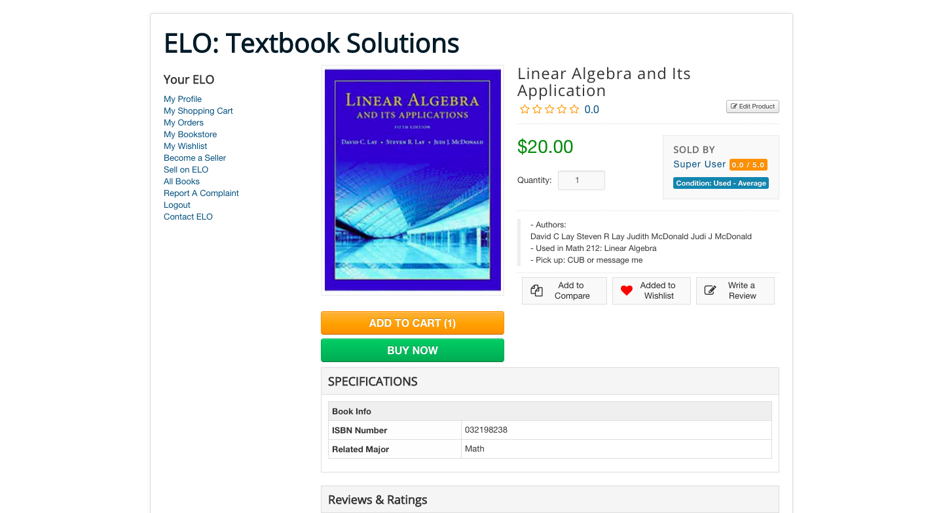
Notes:
The book’s information page displays. Make sure to mention that the students can add information about the book in the description section. (authors of the book, class used, pick up location, etc). Point out ISBN field and Related Major field.

Slide 21
Notes:
Let’s say the student want to buy this book. The student clicks on Add to Cart.

Slide 22
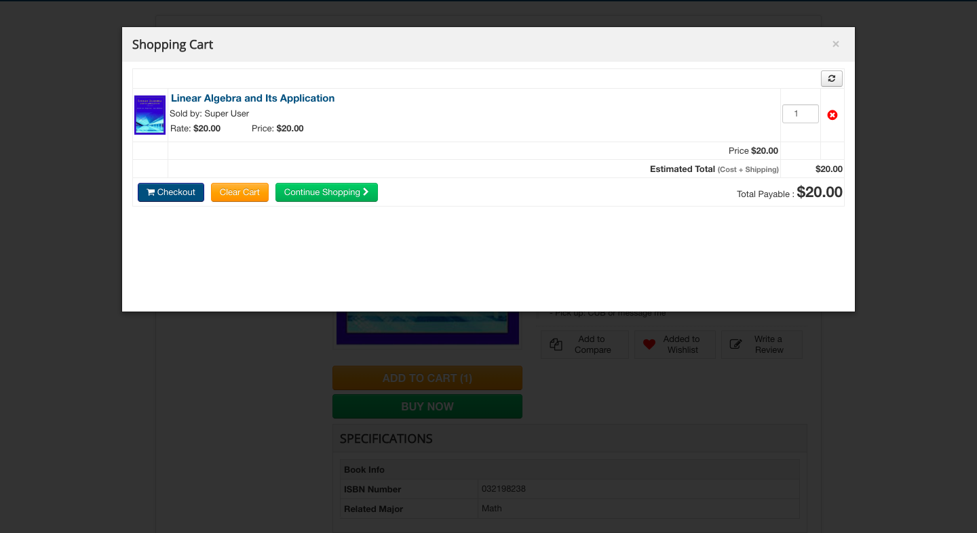
Notes:
A pop-up modal displays with the chosen book information.

Slide 23
Notes:
The student wants to buy the book now. The student will click on Checkout.

Slide 24
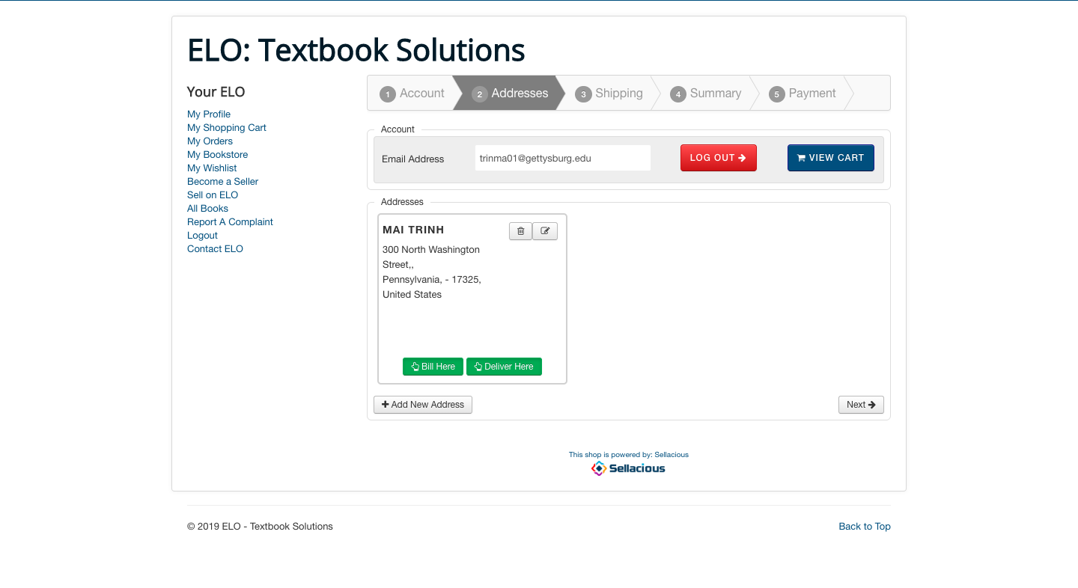
Notes:
The book will be picked up within campus so the student can skip the address section.

Slide 25
Notes:
Click on next to skip the Address section.

Slide 26
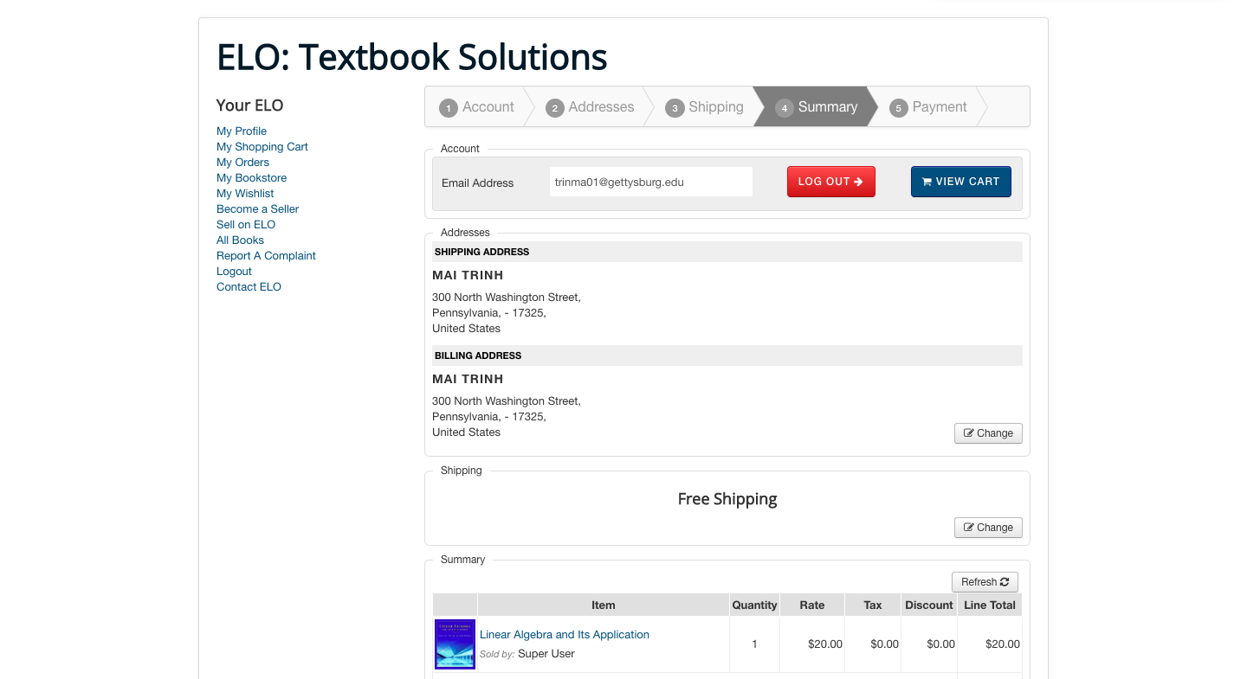
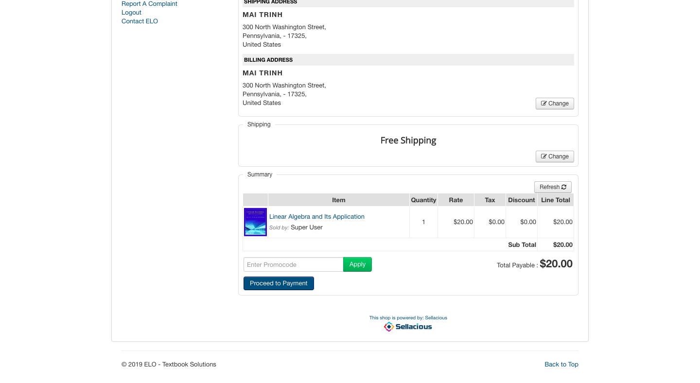
Notes:
The order summary screen displays with the book’s information.
(NOTE: some information on the actual screen has been altered for the purpose of more succinct and effective delivery of necessary information to the audience. We have taken out the account and address sub-section)

Slide 27
Notes:
The student click on Proceed to Payment.

Slide 28
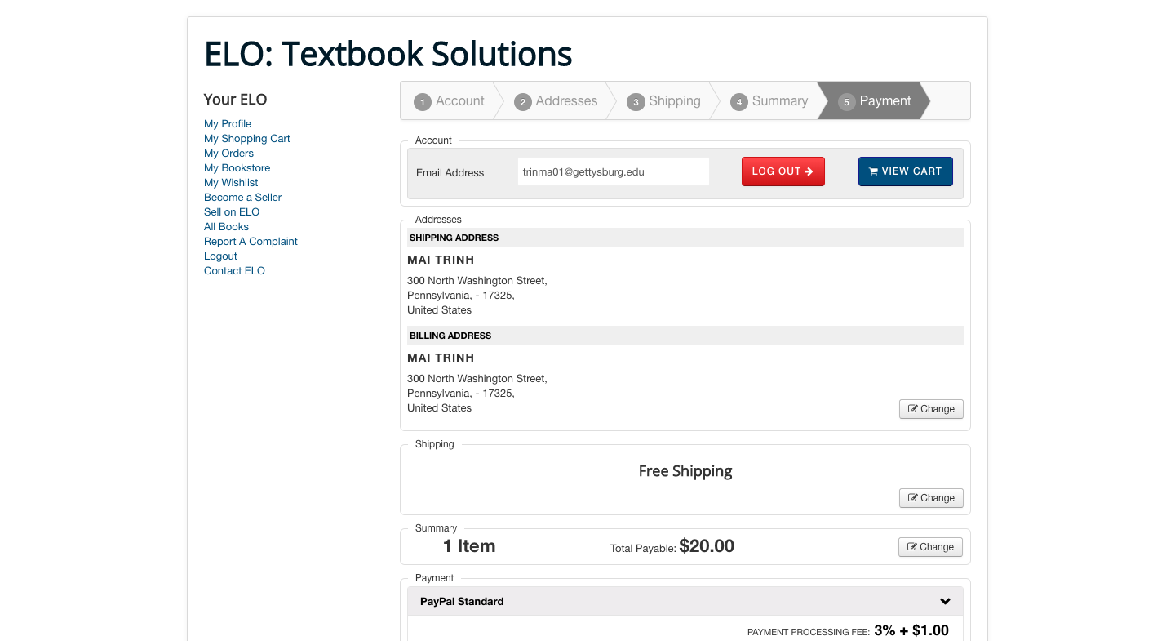
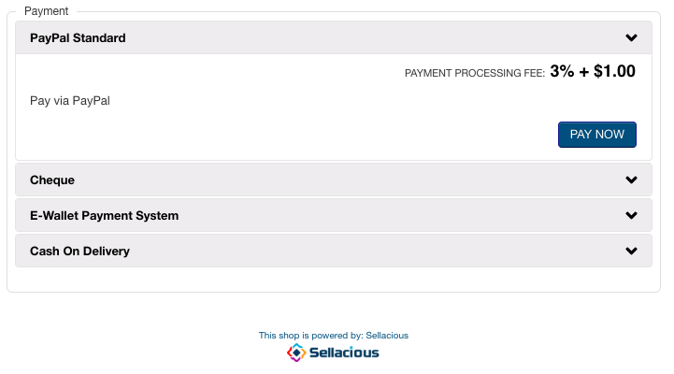
Notes:
The payment option page displays.
NOTE: some information on the actual screen has been altered for the purpose of more succinct and effective delivery of necessary information to the audience.

Slide 29
Notes:
The student clicks on Pay Now.

Slide 30
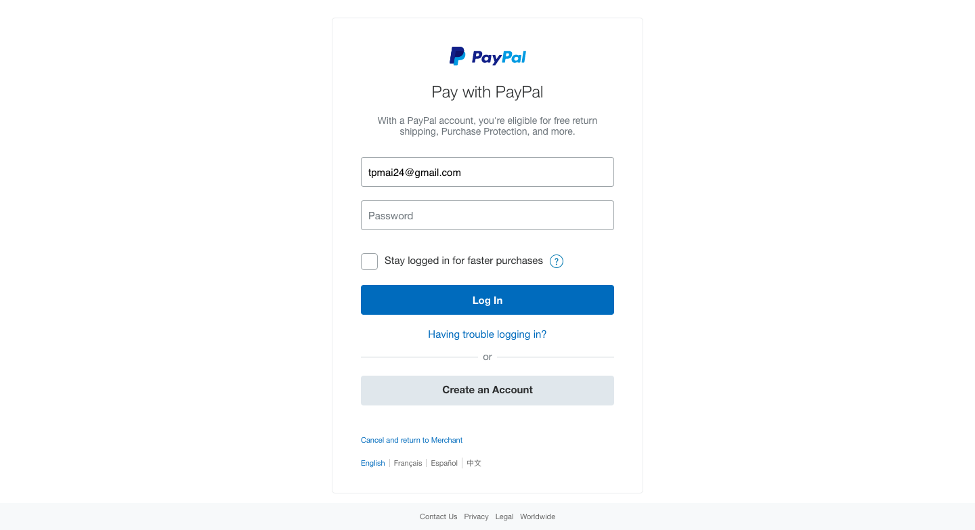
abcde123
Notes:
The student is redirected to PayPal’s payment portal. End use case.

Slide 31
Notes:
After payment, the students can go the sidebar to check their order.

Slide 32
Notes:
Navigate to sidebar and click on My Orders. Speaker demonstrates.

Slide 33
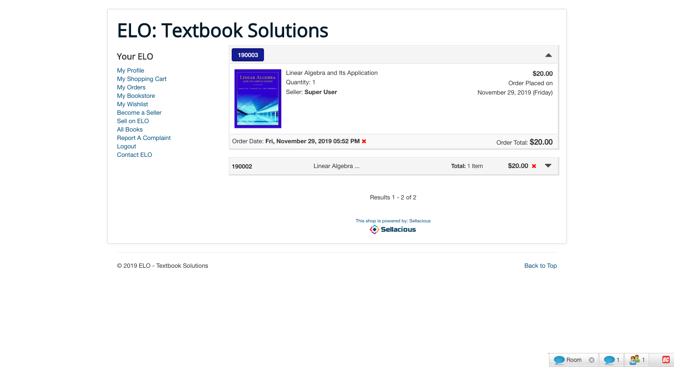
Notes:
The student’s order displays.

Slide 34
Short demo (of the prototype)
Selling a book
Notes:
Scenario: Selling a Book on ELO.

Slide 35
Notes:
Say we are logged in and are on the homepage of the website. If a user wants to sell his/her textbook on ELO he/she has to register as a seller.

Slide 36
Notes:
Say we are logged in and are on the homepage of the website. If a user wants to sell his/her textbook on ELO he/she has to register as a seller.

Slide 37
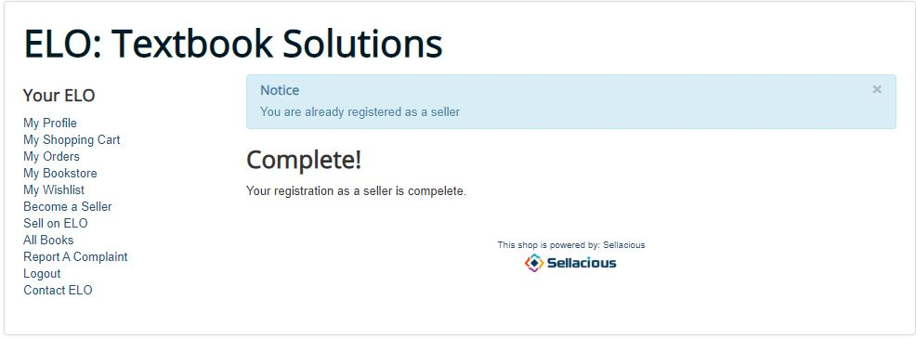
Notes:
Here we can see after a user registers as as a seller, he/she can now start selling on ELO.

Slide 38
Notes:
Here we can see after a user registers as as a seller, he/she can now start selling on ELO.

Slide 39
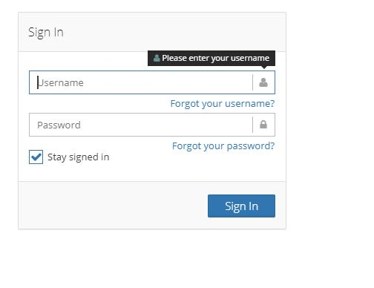
Notes:
User has to enter the login credentials with which he/she was registered as a seller.

Slide 40
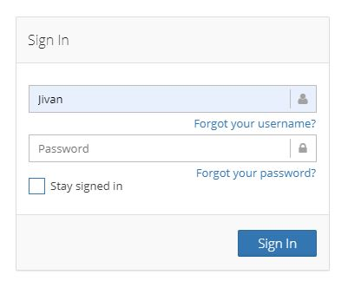

Slide 41
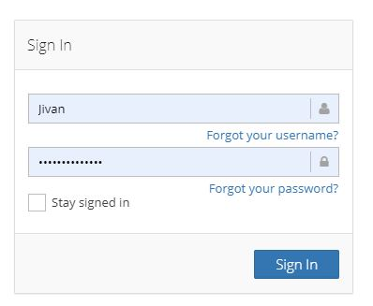
Notes:
User enters password:

Slide 42
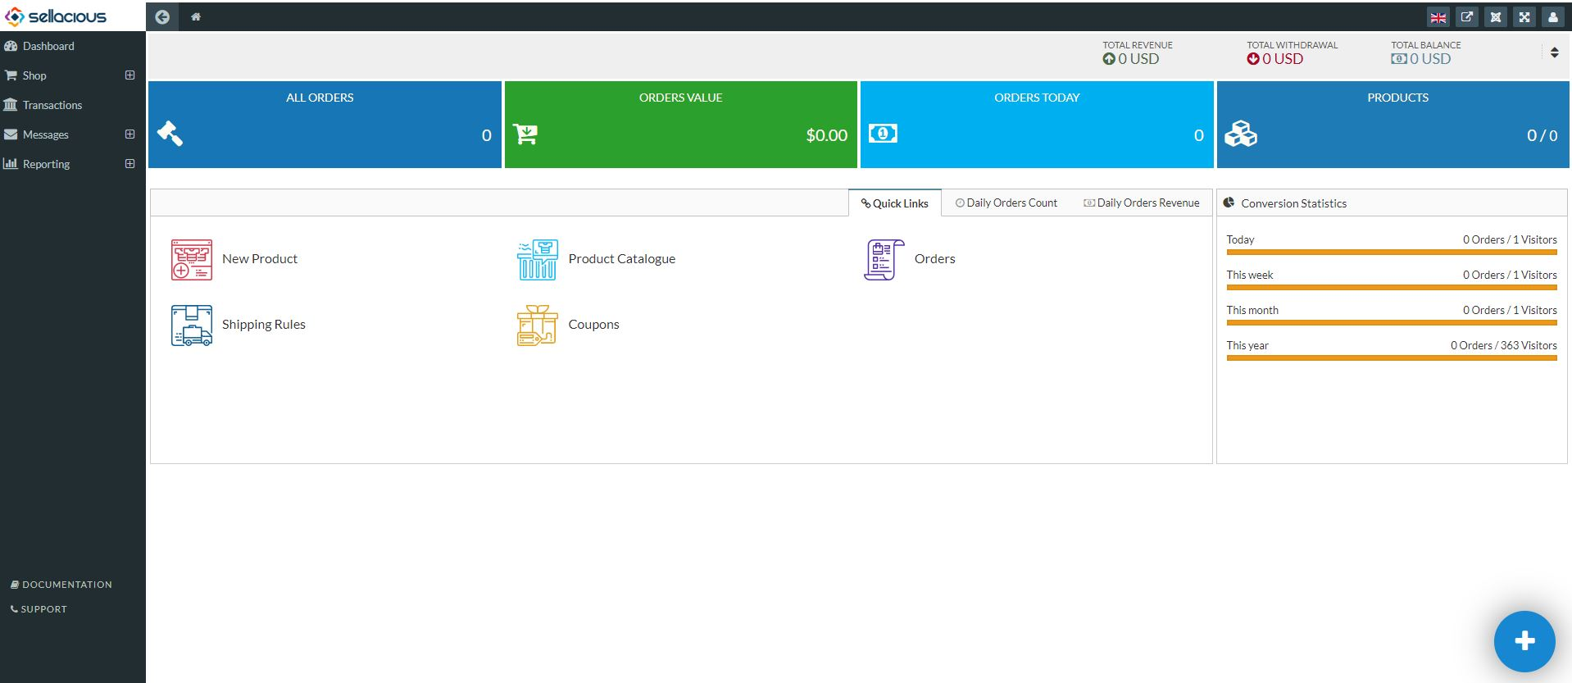

Slide 44
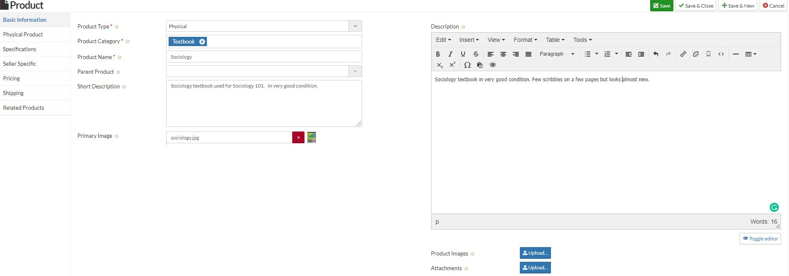

Slide 45
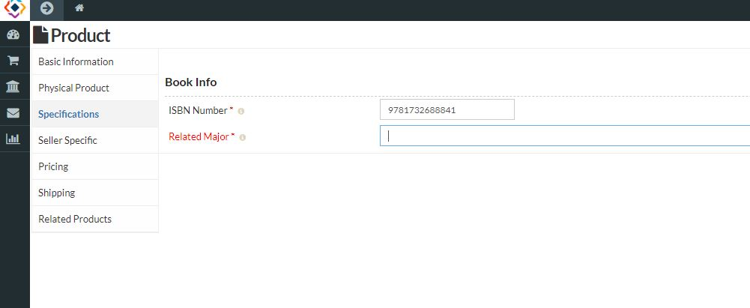

Slide 46
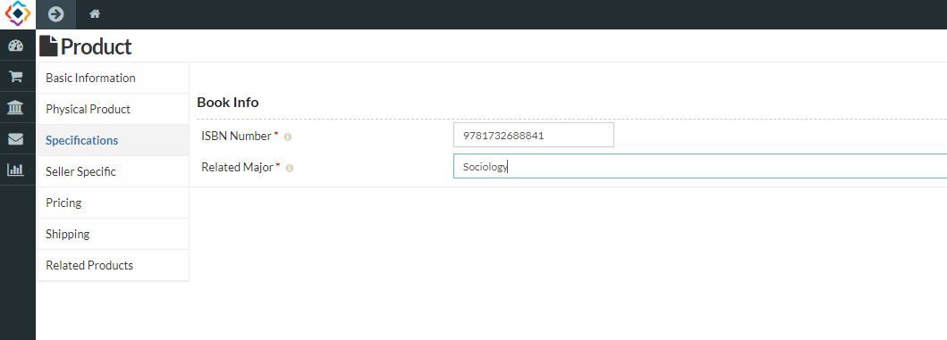

Slide 47
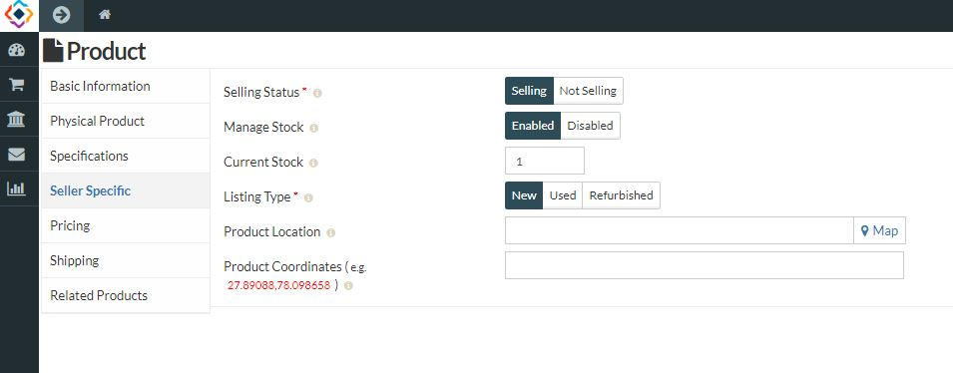
Notes:
Seller specific description allows seller to mark if they are currently selling, add the current stock of product and manage the stock later, and mark if the product is new used or refurbished. If choose used, other options.

Slide 48
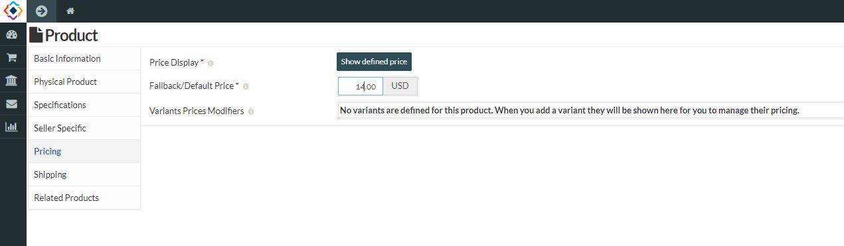

Slide 49
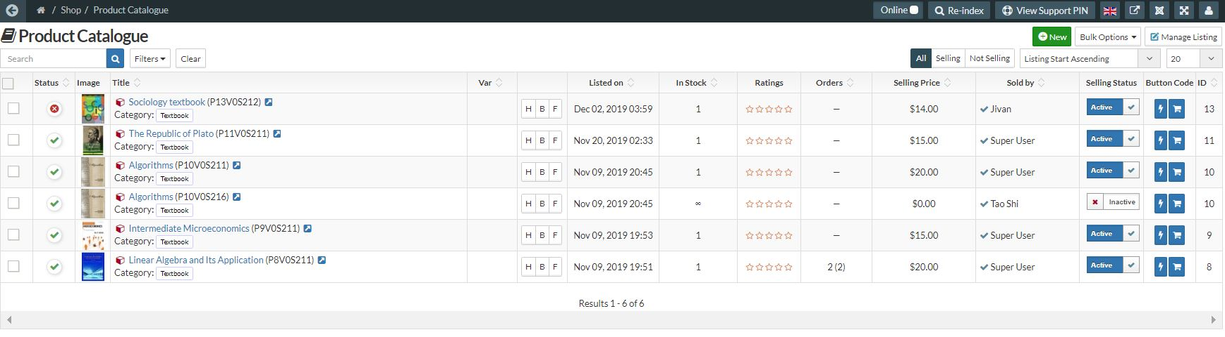

Slide 50
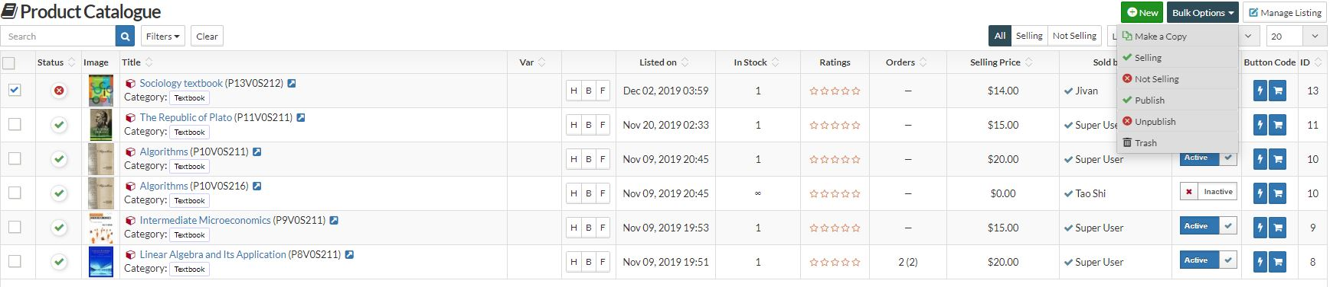

Slide 51
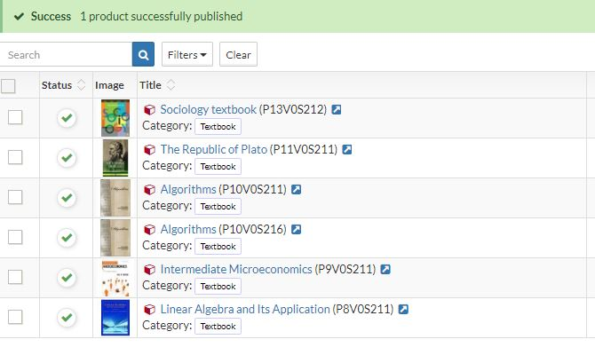

Slide 52
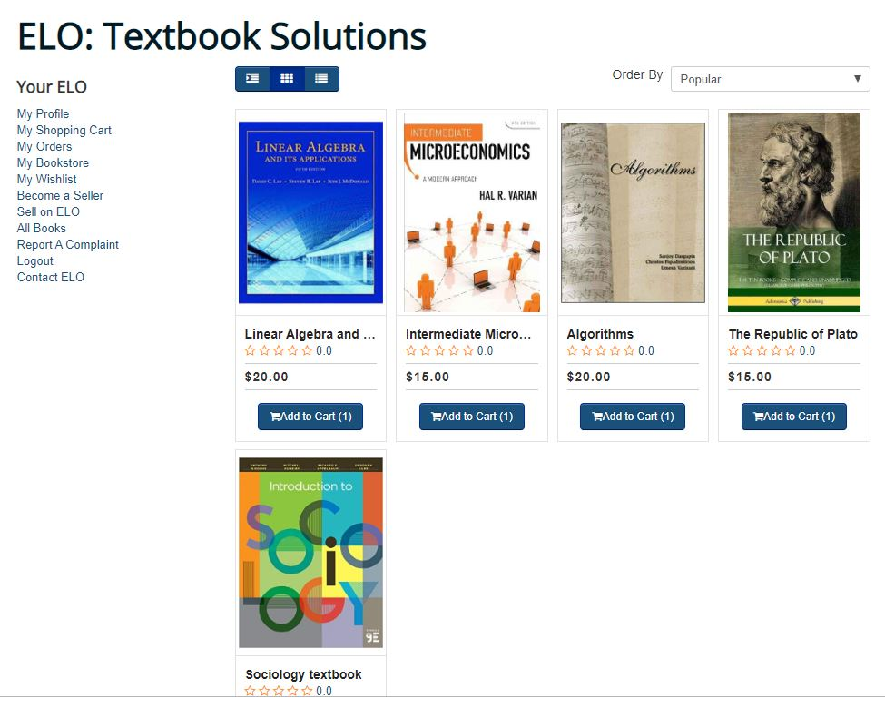
Notes:
The sociology book is now successfully published.

Slide 53
Takeaway & Success
Better understanding about software development life cycle.
Better understanding about teamwork, group dynamics, communication with client, and project management.
Project scale experience working with content management system like Joomla and ecommerce software like Sellacious.
Code comprehension & core understanding is key
Understanding of PCI DSS certification - card information, security

Slide 54
Challenges
Figuring out what platforms might best suit the project requirements.
Understanding the Joomla’s MVC pattern.
Understanding the already existing code base.
Unexpected ‘system crash’ while trying to modify or add code to the existing components (Backup!).
Writing a requirement document.
Client communication.
Incompatibility issues with Bootstrap and Joomla.
Some functionalities from the original plan could not be completed.
Notes:
MVC pattern show password link..
Renting & Push Notification

Slide 55
Questions?

